Slide 1
Surgical instrument and anatomy segmentation of endoscope videos for robotic surgery
Team: Zhaoshuo Li, Hao Ding, Mingyi Zheng

Slide 2
Problem Description
Task type: semantic Segmentation
Background:

Slide 3
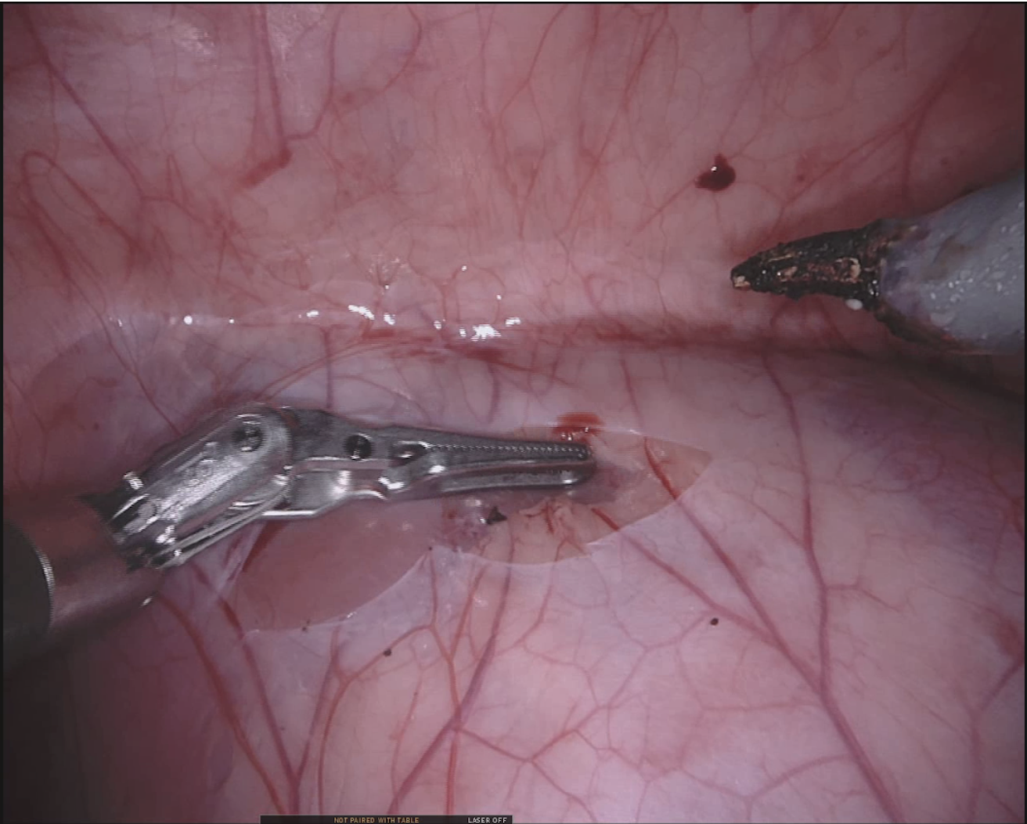
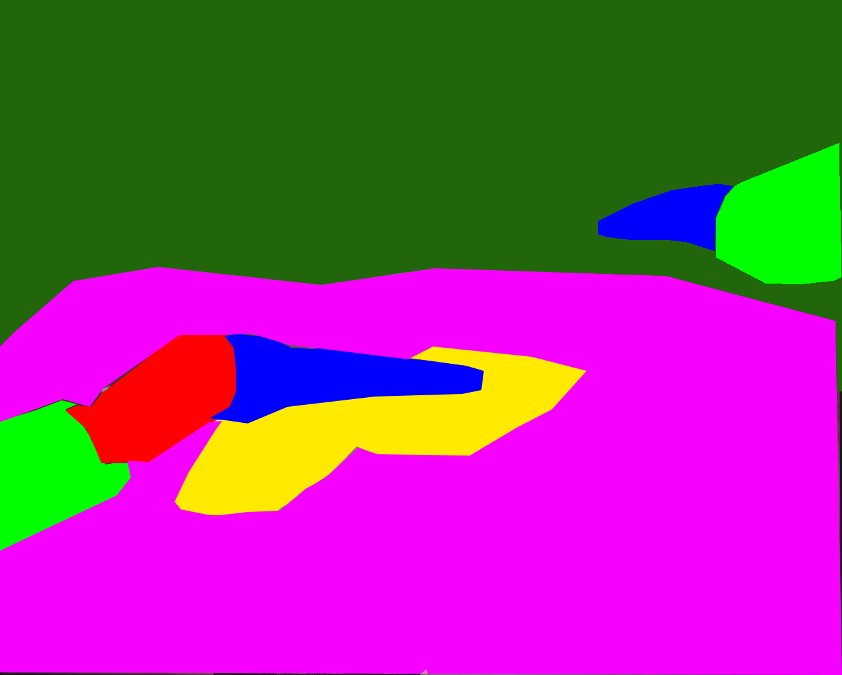
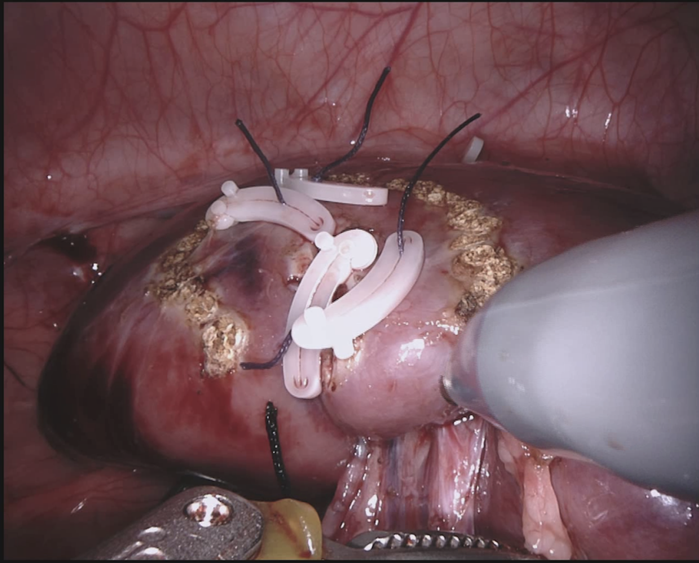

Dataset
Data Source: https://endovissub2018-roboticscenesegmentation.grand-challenge.org/Data/
Number of Classes: 11
Training Dataset: 16 recorded robotic nephrectomy procedures, subsampled by 2 hz. Video frames are 1280x1024.
Test Dataset: 2x500 frame sequences from different recorded porcine procedures
Evaluation Criteria: mean intersection over union (IoU) metric.
Examples:

Slide 4
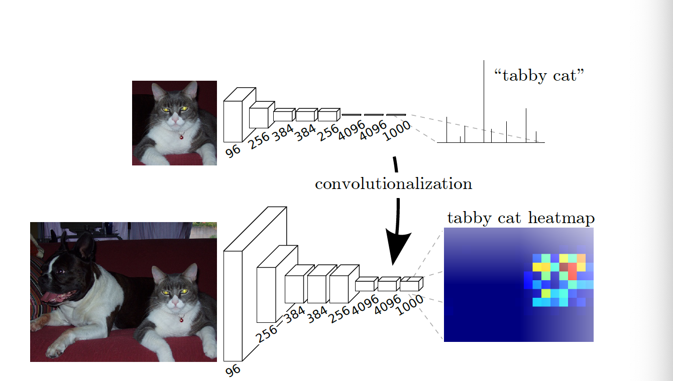
Related Work
1.FCN:
Fundamental Structure for Most of the Semantic Segmentation architectures
Using Convolutional Layers to replace the Fully Connected layer in Classic architectures.
Using transpose convolutional kernel for upsampling features to get pixel-wise predictions.
Using dilated convolutional kernels to expand the receptive field.

Slide 5
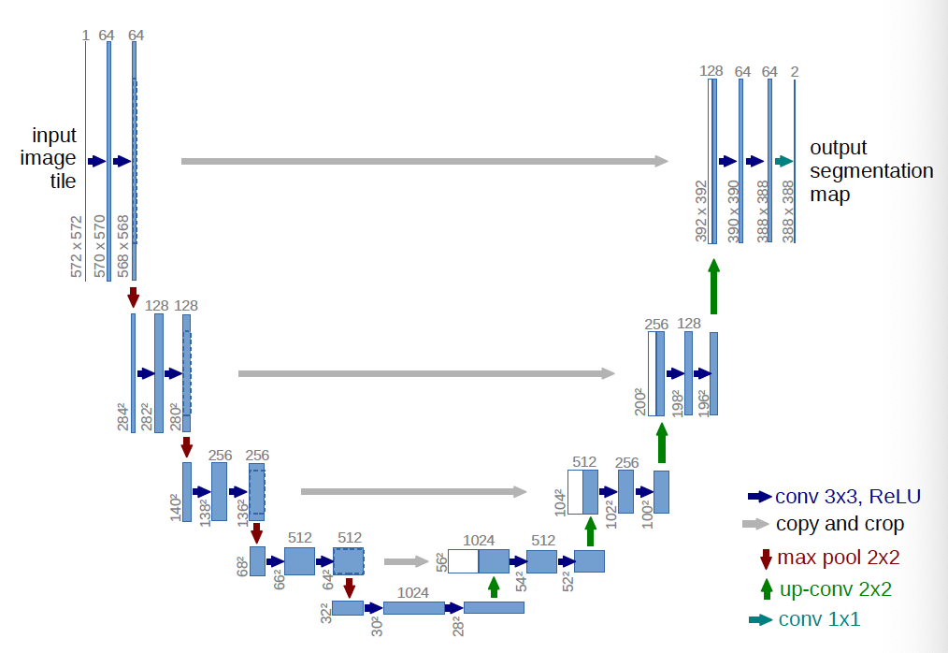
Related Work
2.Unet:
One kind of FCN
Innovation: upsampling high-level features and concat them with low-level features to provide information from deferent scales.

Slide 6
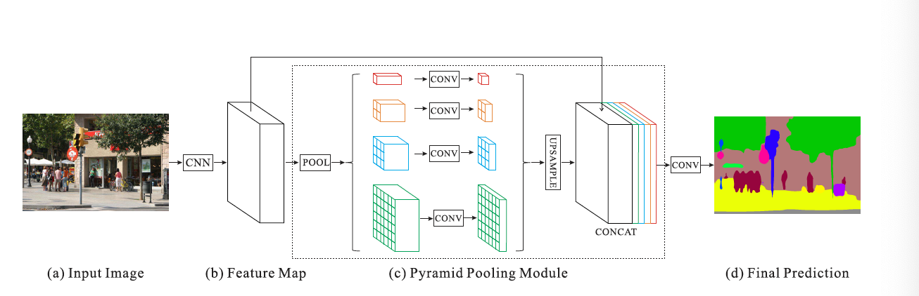
Related Work
3.PSPNet:
One kind of FCN
Innovation:
introducing Pyramid pooling module for the feature map to get features of different scale.

Slide 7
Related Work
4.Conclusion:
Using FCN as basic architecture.
Scale matters.

Slide 8
Our Method (rough ideas):
Using FCN as Basic architecture
Try to get features of different Scales
Try to utilize the fact that the pictures are from sequence, in other word, that they are related along timeline.

Slide 9
Q&A

